Slide 1
Chapter 2: Visual Communication
Design: The Structure of Art
Art Elements/Sensory Properties
Color, Value, Shape, Texture, Space
Principles of Art/Formal Properties
Unity, Balance, Contrast, Rhythm, Pattern, Movement
*Artist use art principles to arrange elements*
Texture – (design element) refers to the quality of the surface; how the surface feels to the touch, or looks like it would feel
Perspective:
Methods Artists Use To Show Depth On A Flat Surface
Overlap
Aerial Perspective – darker values are up close, and lighter values are far away
Linear Perspective – parallel lines run towards invisible vanishing points

Slide 2
Chapter 2: Visual Communication
Design: The Structure of Art
Color:
Primary Colors – Red, Yellow, Blue
Secondary Colors – Green, Violet, Orange
Intermediate Colors – Red-Violet, Blue-Violet, Blue-Green, Yellow-Green, Red-Orange, Yellow-Orange
Cool Colors – green and blue
Warm Colors – red and orange
Hue - one of the twelve colors listed above (the name of the color)
Value – dark or light quality of the color
Intensity – brightness or saturation
Local Color – color of objects when they are lit by white light
High-Keyed – paintings that have mostly light values
Low Keyed – paintings that have mostly dark values
Movement:
Movement in a painting - directs the viewer’s gaze to the center of the work

Slide 3
Commonalities
(Geometric Patterns, Animal Designs, Human Figures, and Architecture)
Tall/Vertical Architectural Structures
(Different Parts of the World)
Egypt – Obelisks
China and Japan – Pagoda Towers
Europe – Gothic Cathedrals
Contemporary Skyscrappers

Slide 4
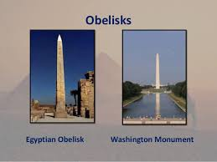
Egypt

Slide 5
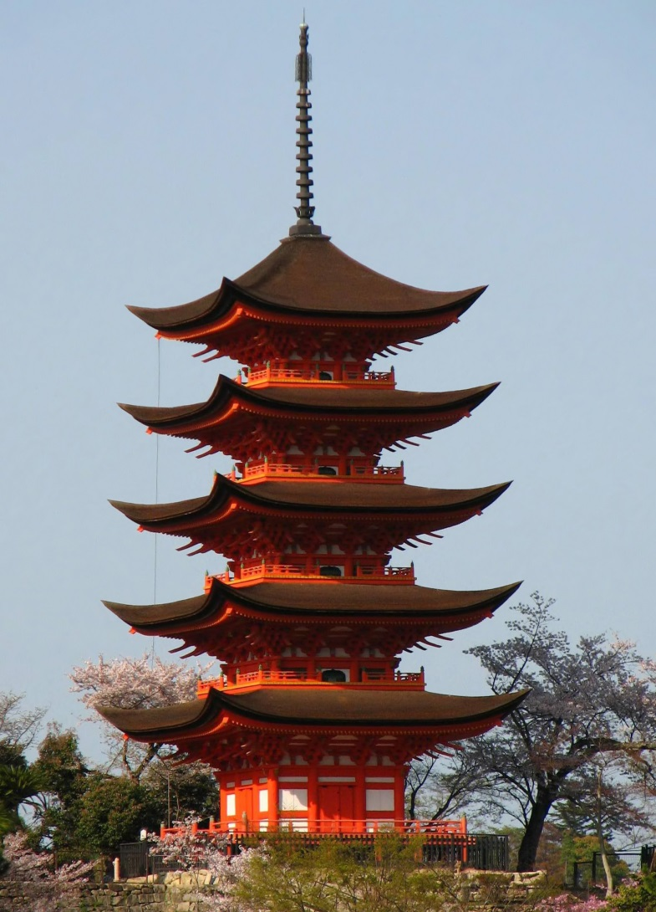
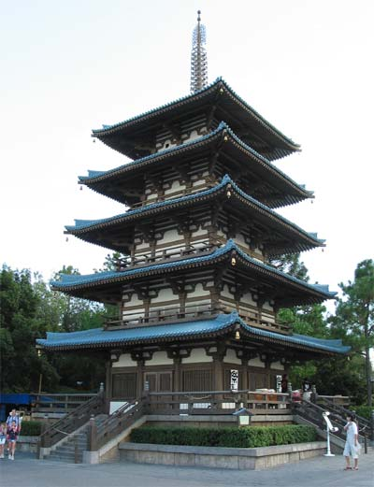
China/Japan
(Pagoda Towers)

Slide 6
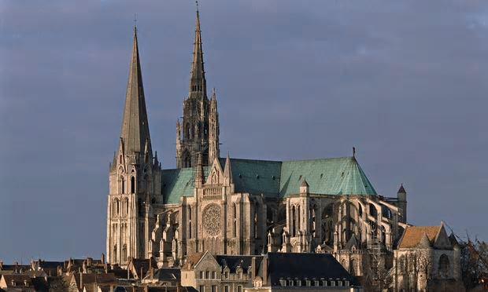
Europe
(Gothic Cathedral)

Slide 7
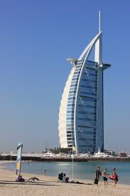
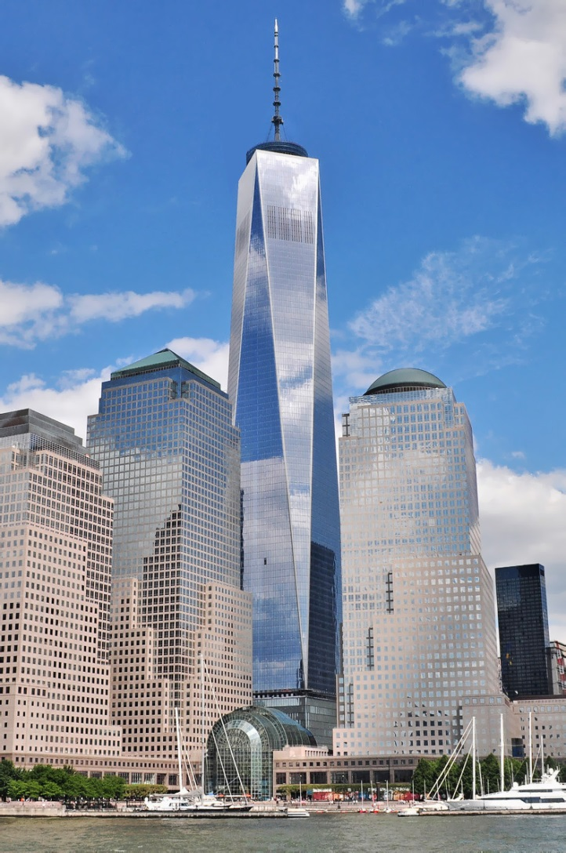
Contemporary Skyscrapers

Slide 8
Commonalities
Cultures That Have Influenced European Artists (19th and 20th Centuries)
Picasso – African Tribal Art
Gauguin – Native people of Tahiti
French Impressionists – Japanese Woodcuts

Slide 9
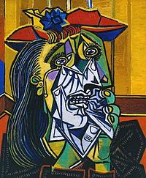
Picasso – The Weeping Woman (1937)
Oil on Canvas
Tate Modern, London

Slide 10
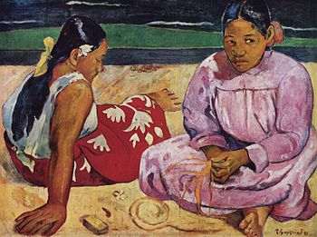
Gauguin – Tahitian Women on the Beach (1891)
Oil on Canvas
Paris

Slide 11
Emotion vs. Intellect
Emotional/Romantic
Intellectual/Classic
Active and colorful interpretation of the subject
Violent movement
Distortion
Bright and vivid colors
Strong interest in nature
Emphasis on design and composition
Analytical approach to the subject
Use of rules and an emphasis on neatness
Proper proportions

Slide 12
Style
Categories of Style in Art
Individual
Period
National/Regional – Diego Rivera (his painting style became a national Mexican style)
Technical
Influences on Style
Teachers
Friends
Environment
Exposure to art in the past
Trompe l’oeil – French term for “fool the mind” objects painted in this style are so lifelike that viewers think they are real

Slide 13
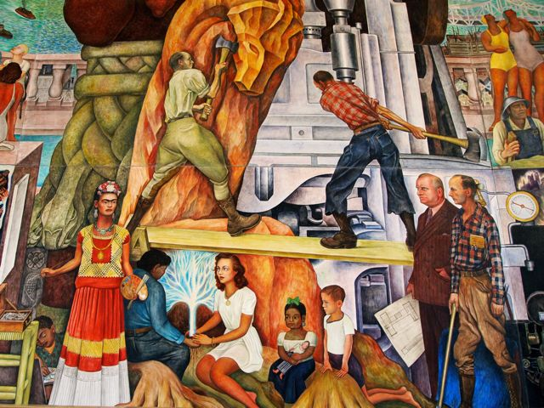
Diego Rivera’s Pan American Unity

Slide 14
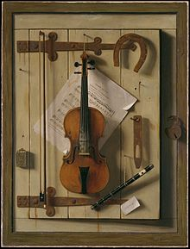
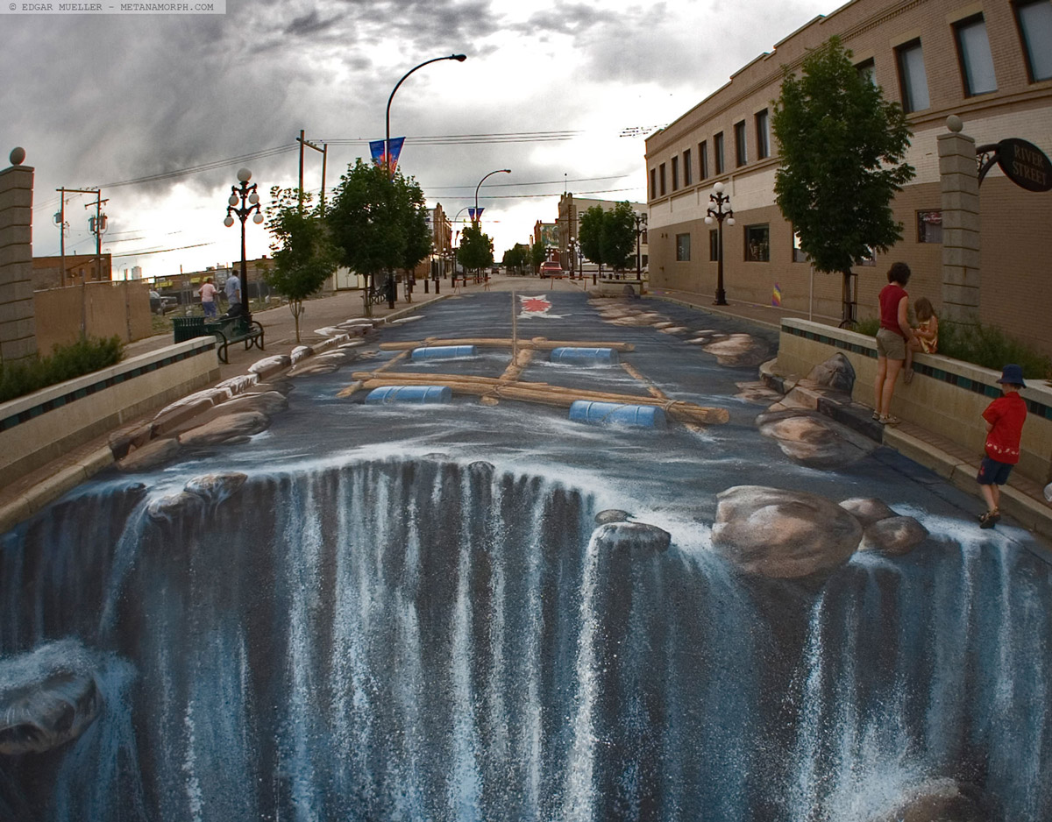
Trompe-l'oeil

Slide 15
Test 2 Review – Structure and Common Denominators
Key Terms (Vocabulary)
Fresco painting
Art Elements
Art Principles
Texture
Primary Colors
Secondary Colors
Intermediate Colors
Cool Colors
Warm Colors
Hue
Value/Intensity
Local Color
High Keyed
Low Keyed
Trompe l’oeil

Slide 16
Test 2 Review – Structure and Common Denominators
Short Answer Questions
List three methods artist use to show depth on a flat surface
List four commonalities that appear in art throughout the world
Identify 4 examples of tall, vertical architectural structures built in different parts of the world
What are some features usually found in emotional art and some that are in intellectual art?
List four influences on style (in art).
True or False Statements – Taken from your notes on “Tools and Materials” (Page 39), and from the Guided Reading Activity on the Search for the Tomb of Tutankhamen (See Handout)

Slide 17
Tools and Materials Review
Four different drawing media – pencil, charcoal (used primarily for sketching), ink, and pastel
Five painting media – fresco, tempera, oil, watercolor, and acrylic
An ink wash is the dilution of inks with water. It was used extensively in Japan and China
Describe the process of fresco painting
Medieval artists added egg yolk to their tempera colors.

Slide 18
Test 2 Review – Structure and Common Denominators (Slide Show)
Emotional or Intellectual Art works (6)
Name the Artist (4)
Diego Rivera’s - Pan American Unity
Picasso’s – The Weeping Woman
Gauguin – Tahitian Women on the Beach
Mystery???

